Slide 1

Safety Automated Spotter
Group 15
Yanlin Ye, E.E
Chris Weech, E.E
Aaron Larson, E.E
Angel Morfa, Cp.E
Notes:
This is our first slide
Chris

Slide 2
Motivation
Solo gym goers wanting to increase their strength and fitness
Create a safer environment for the gym member to workout by him/herself
More fulfilling workout by using this equipment
Allow for every gym member to improve without the need for a trainer
Notes:
Chris:
Moving onto some of the motivation that led to us deciding on this idea and ultimately moving forward into building it. Being avid gym goers we came to the conclusion that there was a lack of fulfilment in gym sessions due to the fact that you are going to the gym solo. That would be the singular greatest motivation to conceive and built this device. Not only will allow for the user to be safer but it now gives the user the ability to workout to exhaustion, particular on the bench press, without the need to worry about their safety being in jeopardy.

Slide 3
Objectives
Create a machine to increase gym safety
Make it possible for users to have a meaningful workout without safety being an issue or concern
Increase the efficiency of a work out by allowing a solo user to push his/herself
Notes:
Chris

Slide 4
Specifications
Function/Feature | Key specification
1.1 The barbell assisted racks shall begin moving up within two seconds halted movement (considered to be a distance < 6 inches) | Within 2 seconds
1.2 The system shall be ready to begin tracking bar movement within 5 seconds after “go” button had been pressed | Within 5 seconds
1.3 The racks shall stop within 0.5 seconds of the laser being broken | Within 0.5 seconds
Notes:
Chris (Re-record)

Slide 5
Design Constraints
The material of the arms need to be lightweight but high strength
Actuators range of motion
Cost
Reaction speed of the actuators
Noise of actuators
Camera position
Physical construction(bench press equipment and housing for actuator) at home
Notes:
YANLIN

Slide 6
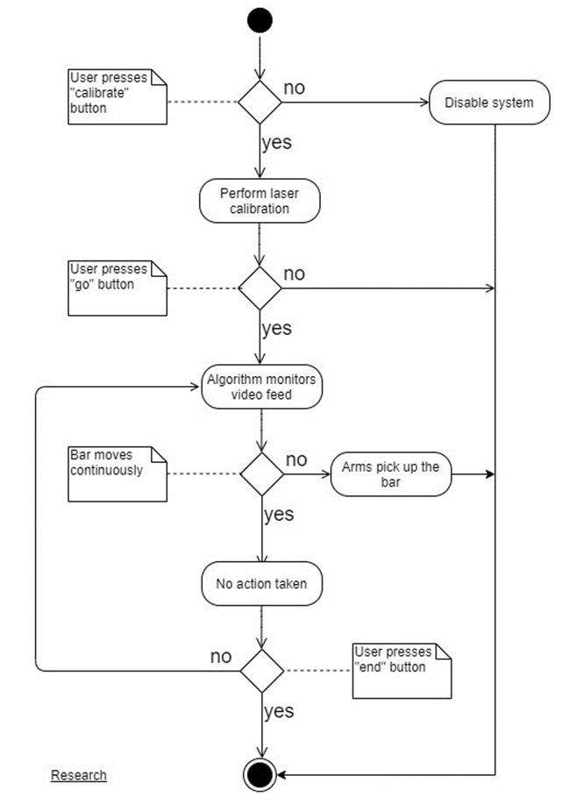
Overall Flowchart
Calibration rep using laser break system
As the user preforms a rep the computer will monitor the movement of the bar
Based on the predetermined safety protocols the system will relieve the user of the weight and lift the bar to its upper resting position
If the user has no issue preforming the exercise the system will act as a standard bench press without interacting with the bar.
Notes:
Aaron

Slide 7
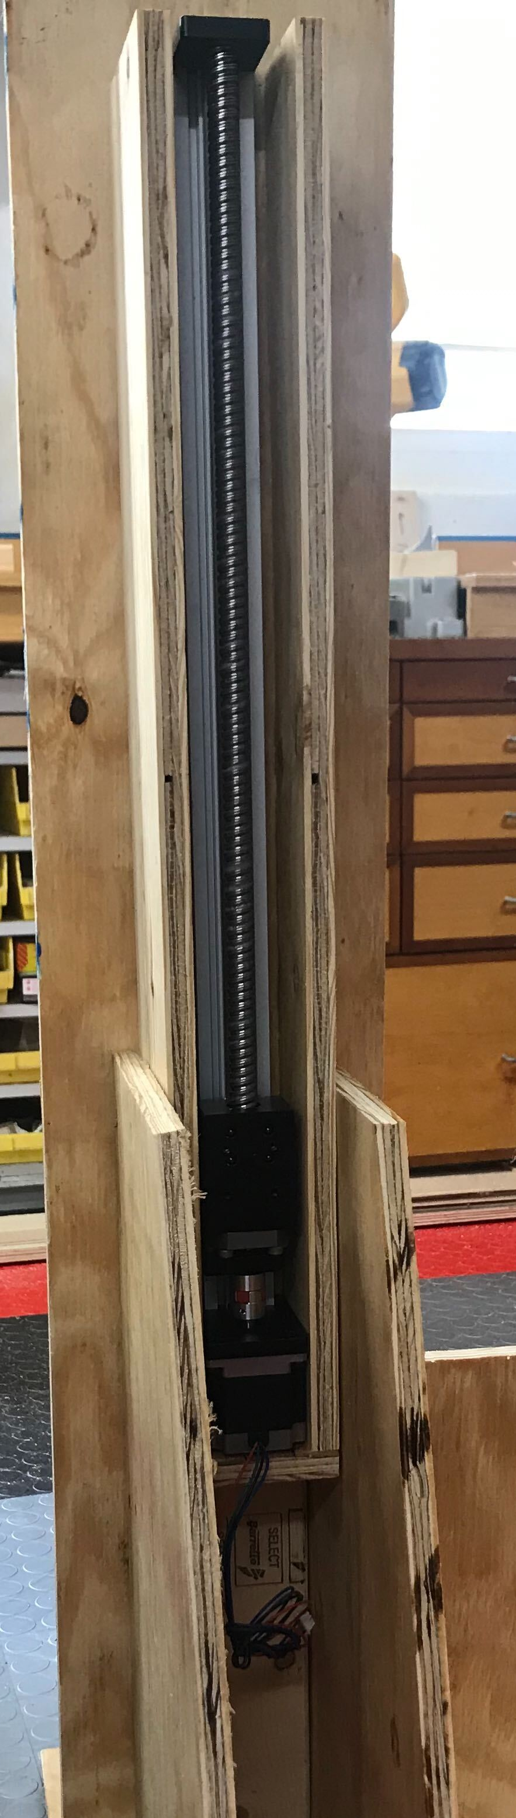
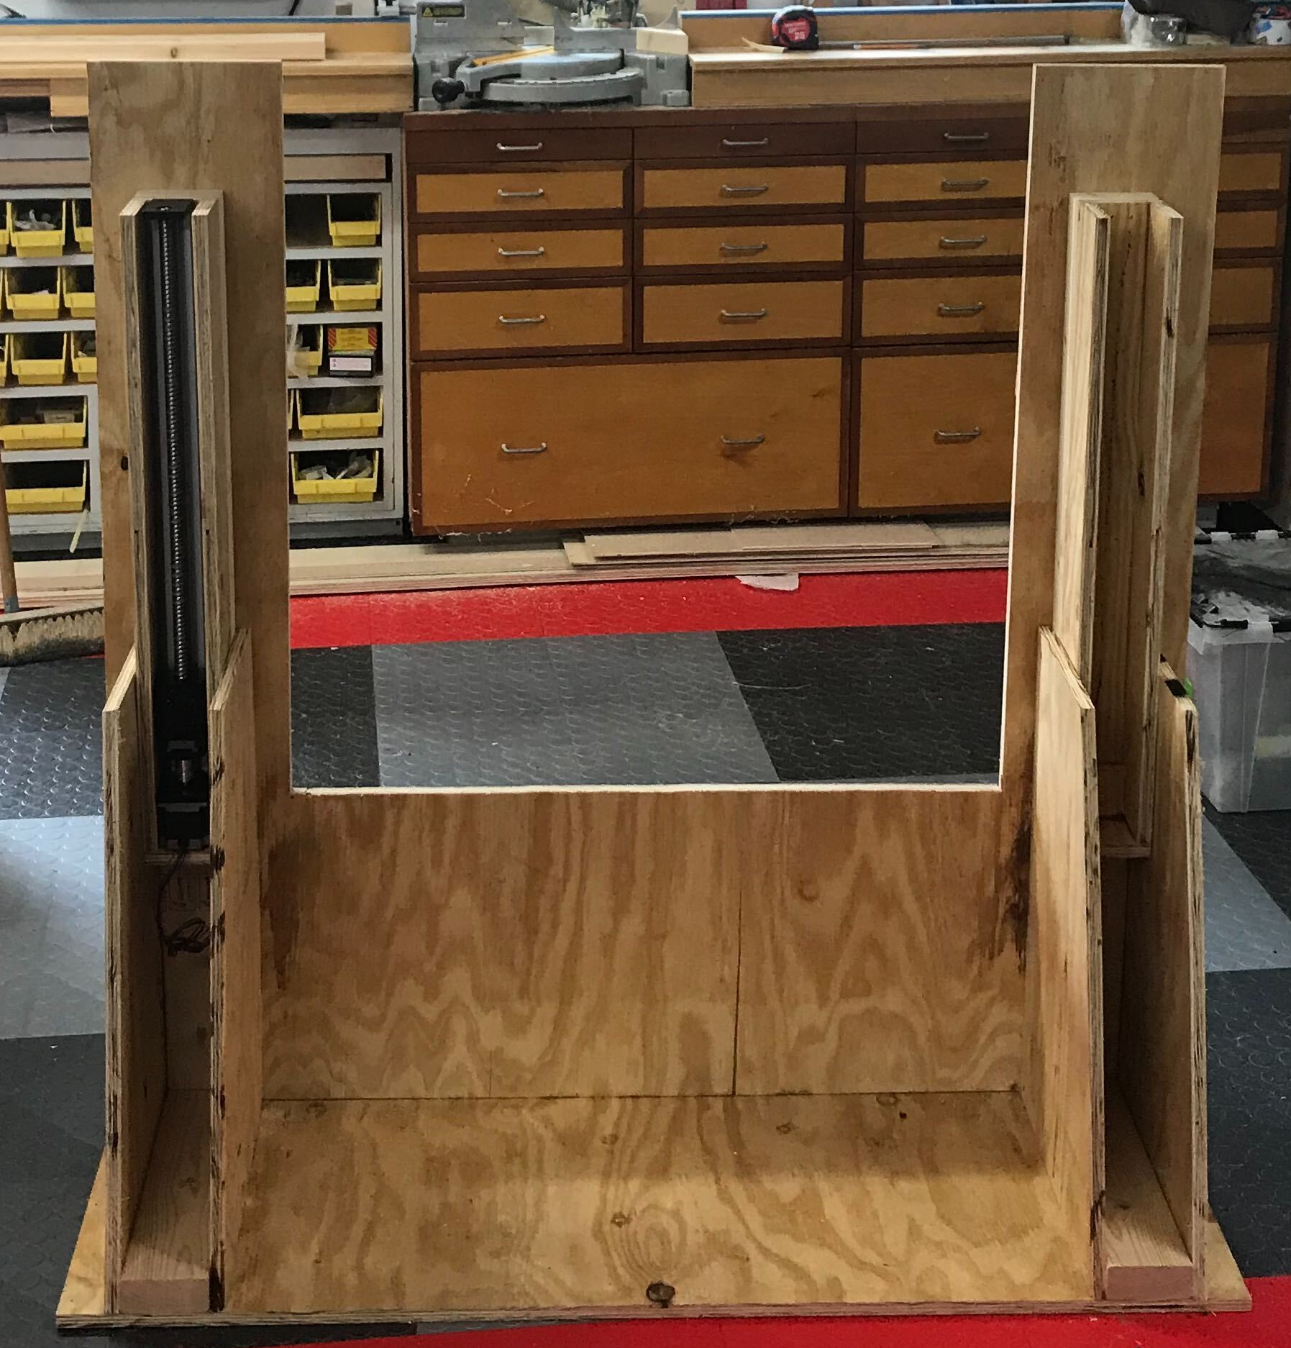
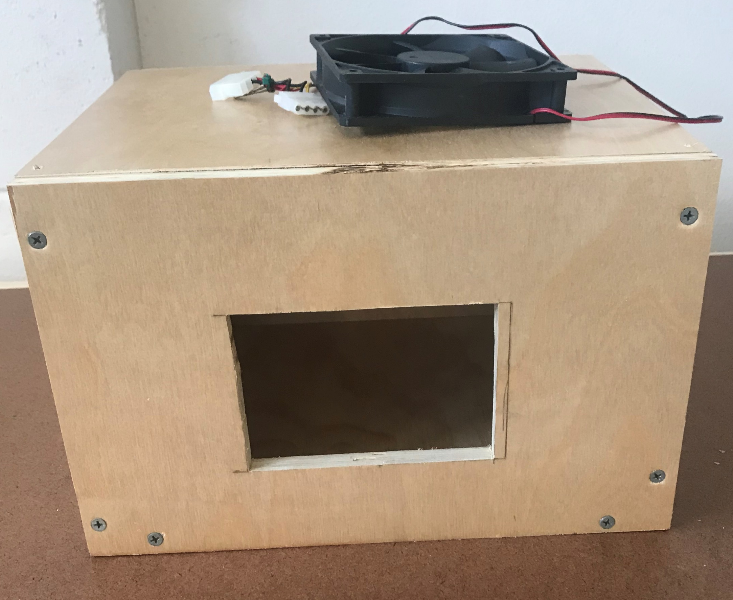
Physical Construction
Wood and fiberglass
Cheap and easy to work with
“Brain Box” with camera will be where the drawers are in the center photo
Notes:
Aaron

Slide 8
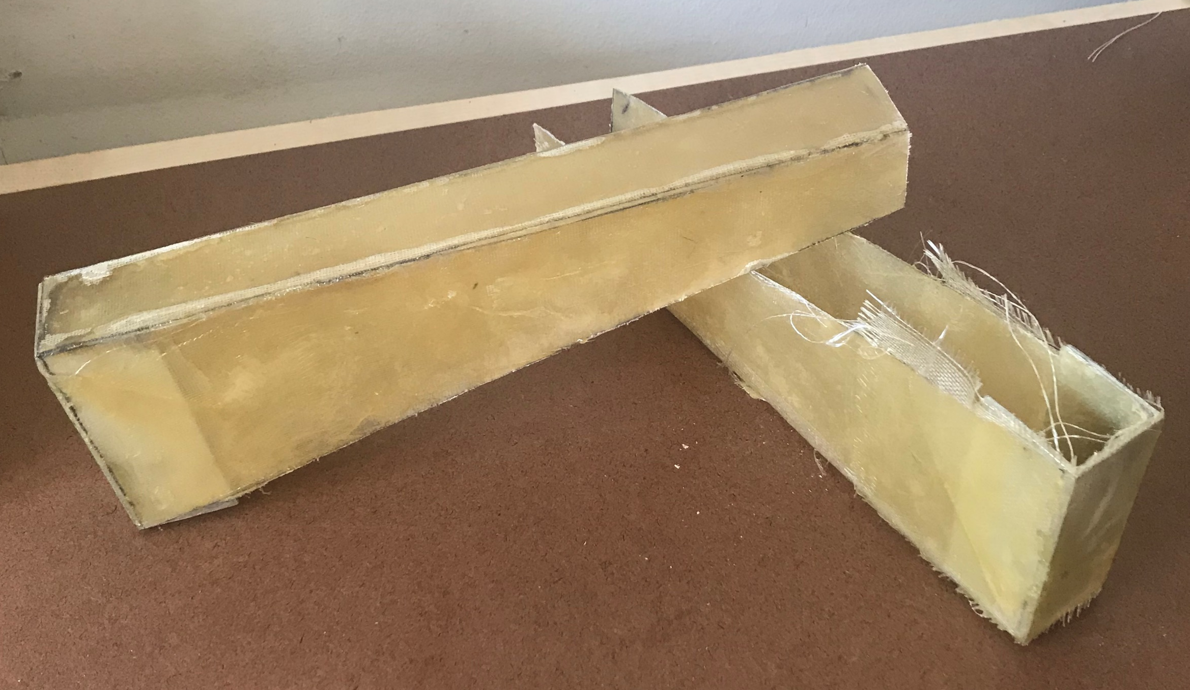
Support Arms
S Glass Fiberglass
Construction
  Flat single layer cut into templates glued together to form shape
  Wrapped glass around the form to build strength
  “U” shaped aluminum back plate to maximize strength
Notes:
Aaron

Slide 9
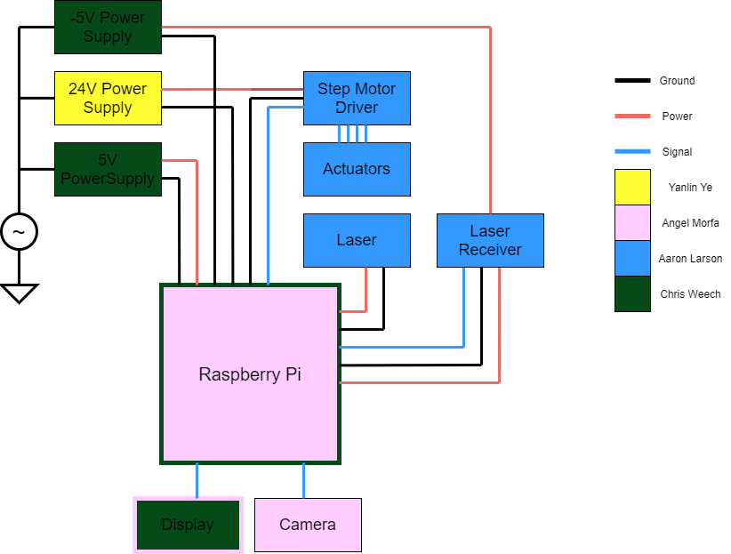
Hardware Block Diagram
Center of our project is the raspberry pi
Almost all of this will go into our “Brain Box”
-5V: negative power rail of the amplifier
24V: Actuator driver
5V: Raspberry Pi power
3.3V from pi to positive power rail of amplifier
All grounds share a common node at the pi to avoid ground loops
Notes:
Aaron

Slide 10
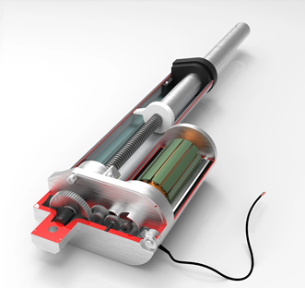
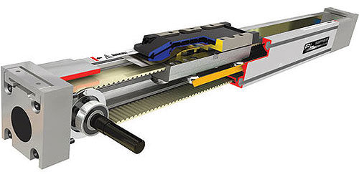
Linear Actuators
Hydraulic vs. Electric
  We chose electric for mobility
  Electric was more accessible
  We didn’t have experience with hydraulic
Belt driven vs. Screw driven
  Belt driven is fast, and usually used for conveyor belts
  Screw driven is slower but can lift a lot more weight
Skew driven linear actuator
Belt driven linear actuator
Notes:
Aaron

Slide 11
Linear Actuators
Feature | LIN-ACHD-25-R1 | FLS40L50005C7 | FA-BH36-224-12
Manufacture | Windy Nation | FUYU | Frigelli
Travel Distance | 24in | 19.685in | 24in
Top Speed | 0.2in/sec | 3.46in/sec | 0.157 in/sec
Supply Voltage | 12V | 1.7V | 12V
Load Capacity | 750lbs. | 33.06lbs. | 224lbs.
Max Current Draw | -- | 2.0A | 1A
Price | $169.99 | $163.00 | $185.00
Notes:
Aaron

Slide 12
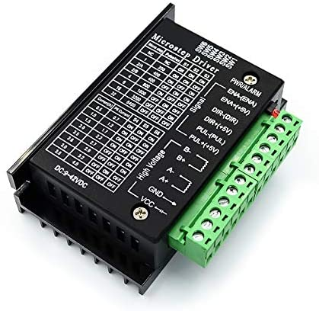
Step Motor Driver
Step motors operate making a full continuous rotation from small incremental step rotations
Step motor drivers produce this specific pulsed signal
Communicate with the driver which signals the motor
Notes:
Aaron

Slide 13
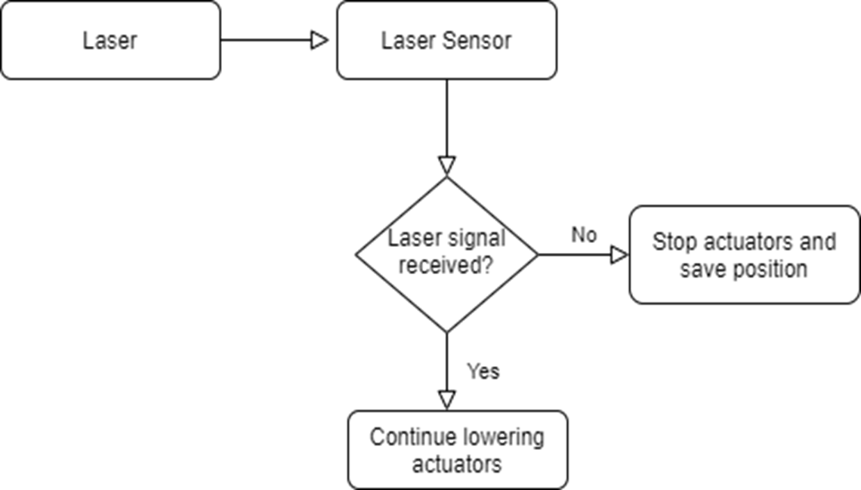
Laser Break System
Consists of laser photodiode and a transimpedance amplifier or current to voltage converter.
When photodiode sees light the output of signal is high(3.3V) because the photons from the light cause the pn junction to flow current, creating a voltage over Rf.
The actuators continue to lower until the output of the amplifier is low. In our case we were able to shield the diode from ambient light to get down to about 0.2V
Notes:
Aaron

Slide 14
Photodetector
Photoresistor vs. Photodiode vs. Phototransistor
Response time
  Diode vs. Transistor, number of junctions
Information presented is for a flash length experiment with photodetectors are in a voltage divider configuration
 | Photoresistor | Photodiode | Phototransistor
Response Time (Rise) | 5us | 2us | 3us
Response Time (Fall) | 10us | 5us | 6us
P-N Junctions | N/A | 1 | 2
Notes:
Aaron

Slide 15
Photodiode
Surface area was the most important factor
Feature | SFH 2201 | ADPD2140 | PDB-C160SM
Manufacture | Osram | Analog Devices | Luna
Photo Sensitive Area | 8.12mm² | 0.31mm² | 7.02mm²
Dark Current | 1nA | 1.74pA | 2nA
Photocurrent | 13uA |  | 80uA
Reverse Voltage | 16V | 8V | 32V
Peak Wavelength | 950nm | 850nm | 850nm
Response Time | 40nS | 227nS | 20nS
Price | $1.38 | $4.85 | $4.71

Slide 16
Power Supply (Actuators)
Features | RS-35-12 | EAG-24-15 | RS-15-12
Dimensions | 99.06mm x 81.79mm x 35.05mm | 200mm x 99.06mm x 50.8mm | 62.48mm x 50.8mm x 27.94m
Efficiency | 84.5% | 85% | 81%
Fault Protection | Short Circuit, Overload, Over Voltage | Short Circuit, Overload, Over Voltage | Short Circuit, Overload, Over Voltage/Temp
Input Voltage | 88-264 V_{ac} | 88-264 V_{ac} | 80-265 V_{ac}
Cost | $14.79 | $25.96 | $7.80
Output Voltage | 12V_{DC} | 24V_{DC} | 12V_{DC}
Output Current | 3A | 15A | 1.3A
Output Power | 36 W | 360W | 15W
Notes:
Chris (Re-record)

Slide 17
Power Supply (Raspberry Pi and Laser)
Features | RS-35-5 | RS-15-12 | RS-15-5
Dimensions | 99.06mm x 81.79mm x 35.05mm | 62.48mm x 50.8mm x 27.94m | 62.48mm x 50.8mm x 27.94m
Efficiency | 84.5% | 81% | 81%
Fault Protection | Short Circuit, Overload, Over Voltage | Short Circuit, Overload, Over Voltage/Temp | Short Circuit, Overload, Over Voltage/Temp
Input Voltage | 88-264 V_{ac} | 80-265 V_{ac} | 80-265 V_{ac}
Cost | $14.79 | $7.99 | $7.80
Output Voltage | 5V_{DC} | 12V_{DC} | 5V_{DC}
Output Current | 7A | 1.3A | 3A
Output Power | 35 W | 15W | 15W

Slide 18
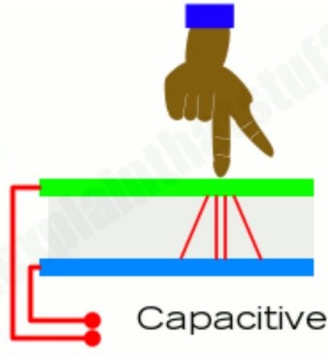
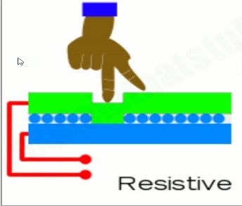
Touch Screen
Capacitive vs Resistive
Capacitive Configuration
Advantages | Disadvantages
Higher touch sensitivity | More expensive to produce
Supports multi-touch | Cannot be used with most gloves
Great visibility even in sunlight | Does not work with pointed objects (stylus etc.)
Resistive Configuration
Advantages | Disadvantages
Very inexpensive to produce | Not very sensitive to touch
Better resistance to dust and water | Multi-touch is not supported
Can be used with gloves | Poor visibility in sunlight
Notes:
Chris (Re-record)

Slide 19
Touch Display
Features | Raspberry Pi 7” | Raspberry Pi 5” | TFT
Display Size | 177.8mm | 127mm | 127mm
Pixel Resolution | 800 x 480 | 800 x 480 | 800 x 480
Screen Configuration | Capacitive | Capacitive | N/A
Viewing Area | 154.08 x 85.92mm | 110.3 x 66.9mm | 110.3x 66.9mm
Cost | $65 | $40 | $31
Dot Size | 0.1926 x 0.1926mm | 0.135 x 0.135mm | 0.135 x 0.135mm
Necessary Voltage | 3.3V | 3.3V | 3.3V
Notes:
Chris

Slide 20
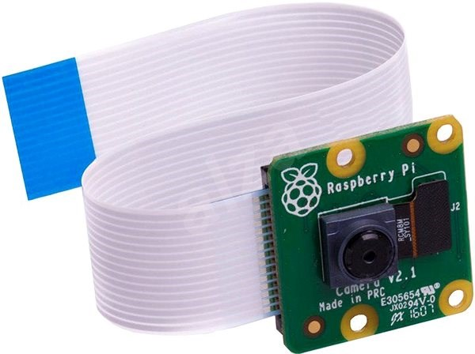
Camera- Raspberry Pi Camera Module v2
Operating Voltage | -
Resolution | 8-megapixel
Video mode | 1080p30, 720p60, 480p90
Price | $21.38
Board size | 25mm x 23mm x 9mm
Onboard processor | No
Sensor Resolution | 3280x2464
Camera Serial Interface Type 2(CSI-2)
15-Pin ZIF connector
Notes:
yanlin

Slide 21
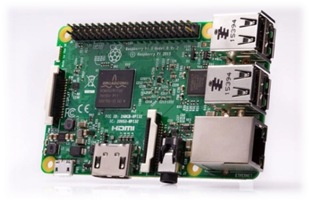
Computer
Raspberry Pi 3B
Compatible with display
Very versatile in the languages that can be used
Documentation and reference projects are readily available
Relatively low price point for a robust piece of equipment
Notes:
Chris

Slide 22
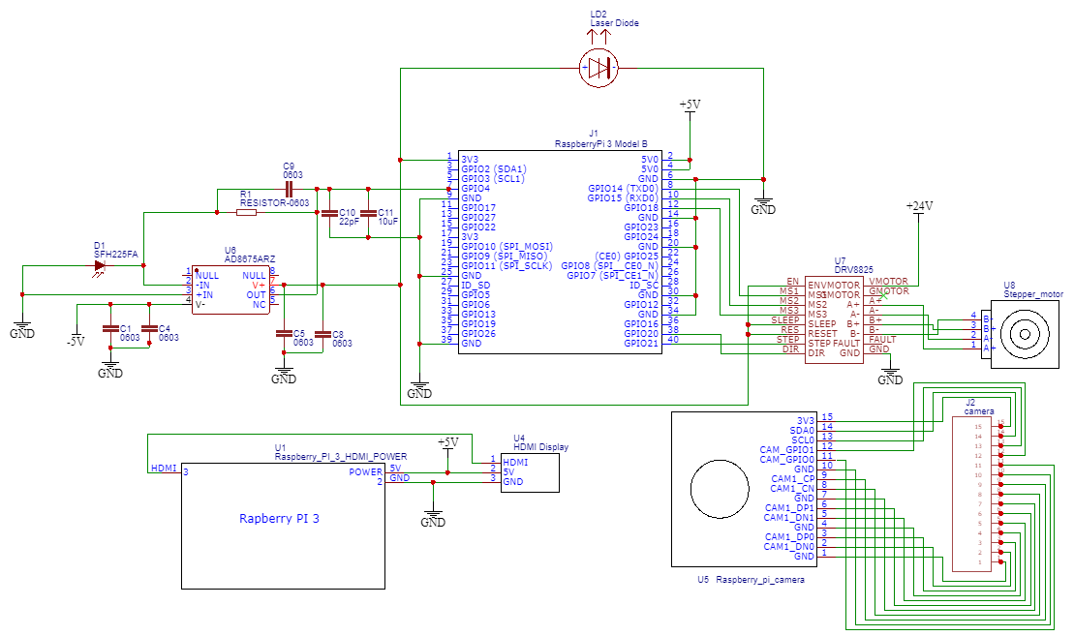
Schematic
Notes:
Aaron

Slide 23
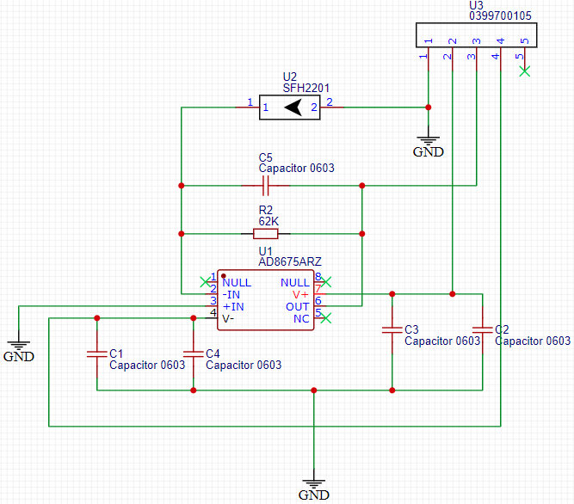
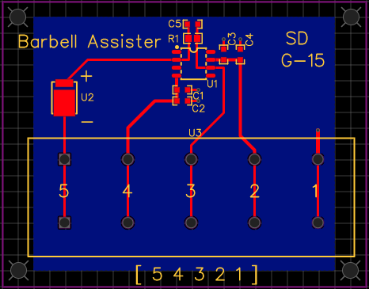
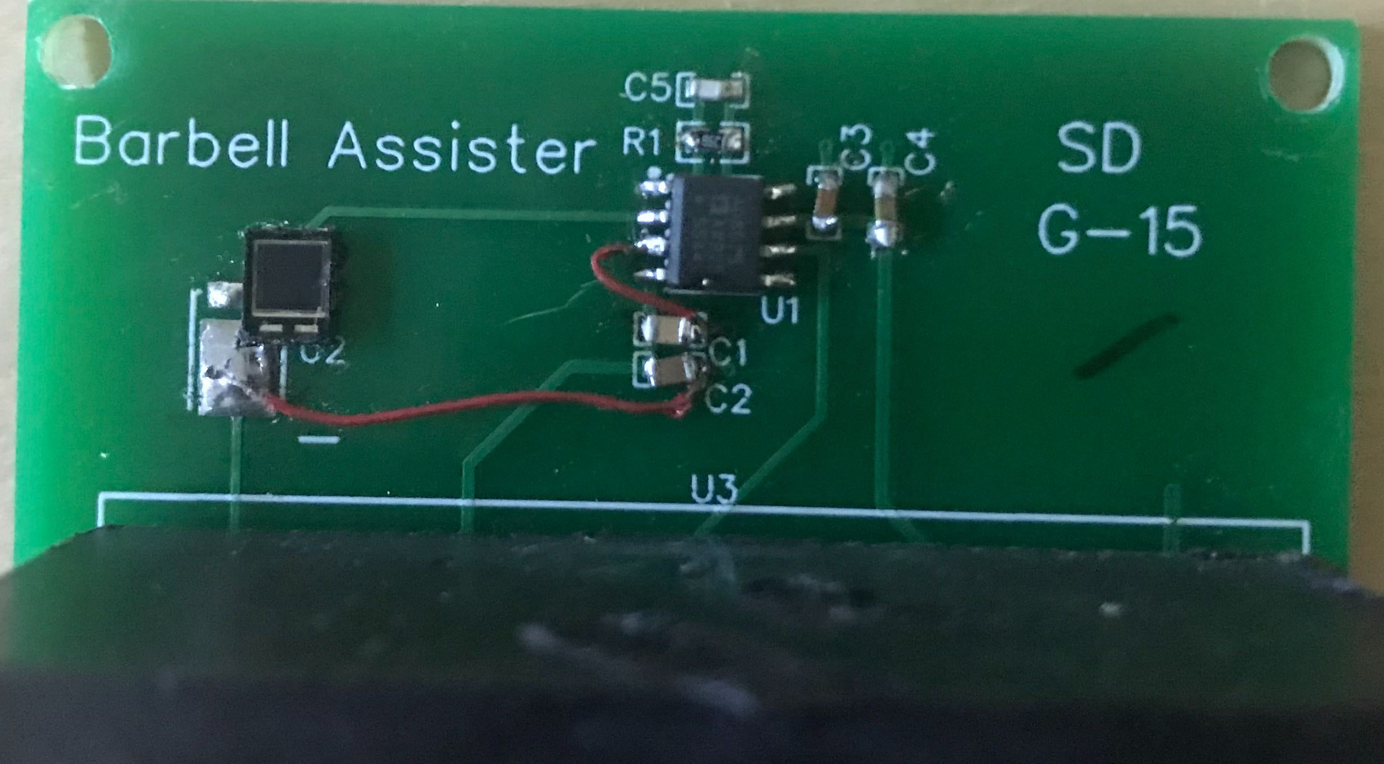
PCB
The only circuit on the PCB is the transimpedance amplifier using the AD8675 op-amp from analog devices
U3 is a connector to communicate with the raspberry pi in the “brain box”
Grounded inputs and power rails: -5V, 3.3V
  Grounded inputs made dark current zero(0V)
  Gave us a peak output of 3.3V when illuminated
To limit inductance and ensure a clean output we have designed the capacitors to be as close to the pins as possible
Notes:
Aaron

Slide 24
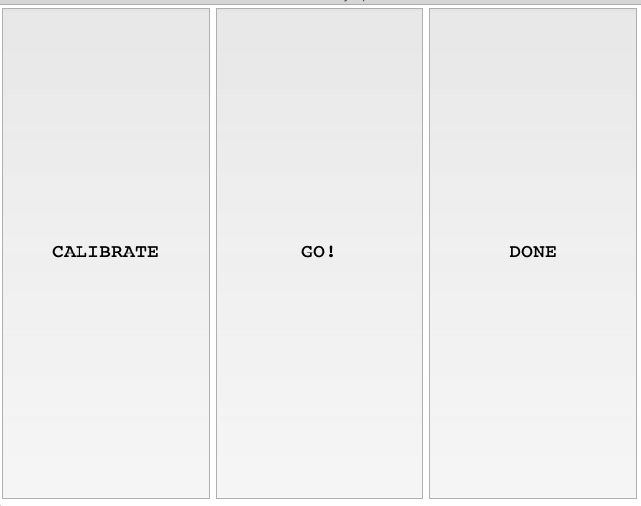

Software
Programming Language chosen: Python.
Code was separated into modules for better organization & readability.
Computer Vision libraries chosen: OpenCV and numpy.
GUI library chosen: Tkinter
Communication with actuators & photodiode via Raspberry Pi GPIOs
 | Simplicity (1-3) | Demand | Documentation
C++ | 1 | High | Good
Python | 3 | High | Good
Java | 2 | Medium | Good
MATLAB | 2 | Medium | Good
OCTAVE | 2 | Low | Poor

Slide 25
Criteria for selecting a sensor
Microwaves & ultrasonic sensors are cheap but have low learning potential.
Lidar technology is in demand, but high-quality sensors are expensive.
The Pi Camera was inexpensive & it opened the door to Computer Vision libraries.
 | Accuracy & precision | Open-ended design | Price | Learning Potential | In-demand technology
Microwave | high | no | <$2.00 | low | no
Ultrasonic | high | no | <$3.00 | low | no
Lidar | high | no | <$40.00 | low | yes
Camera | high | yes | <$65.00 | high | yes

Slide 26
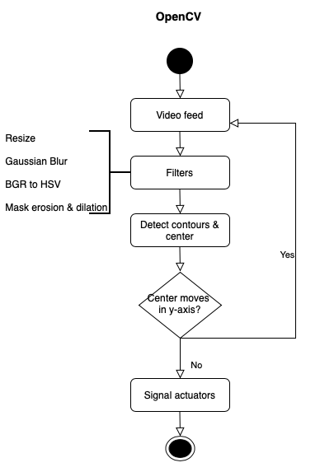
Computer vision (OpenCV) Flowchart
Each frame in the video feed is resized & blurred
to help the Raspberry Pi process them.
Each frame is converted to the HSV color model,
which is better for object detection.
Contours are drawn around the color being tracked
(a rectangle) & its center x,y coordinates are saved.
If a delta y value of more than 60 (pixels) occurs, the
bar is considered to be moving. If delta y is less than
this for 2 consecutive seconds, the actuators are
triggered.

Slide 27
Work Distribution
 | Yanlin Ye | Chris Weech | Aaron Larson | Angel Morfa
Construction |  |  | Primary
Power Supply | Secondary | Primary
Laser Break System |  |  | Primary
Schematic | Primary |  | Secondary
PCB | Secondary |  | Primary
Open CV |  |  |  | Primary
Computer |  | Secondary |  | Primary
Display |  | Primary |  | Secondary

Slide 28
Project
Budget
Component | Price
Laser (adafruit 1054) | $5.90
Photodiode(SFH 2201) | $1.38
TFT Display | $39.99
Power Supply | $25.96
Computer (Raspberry Pi 3 Model B) | $0
Linear Actuators (FLS40L) | $163 x2
Stepper Motor Driver (TB6600) | $11.99
Barbell | $5.00
Wood for Actuators and Control Center Housing | $70.00
Fiberglass | $20.00
Hardware | $30.00
Camera( Raspberry pi camera V2) | $21.38
Misc | $10.00
PCB | $22.00
Total | $590
Notes:
YANLIN

Slide 29
Challenges Encountered
Deciding what equipment is best to act as for lifting bar
Finding ways to track the bar
Finding a display that is compatible with our project
Finding the power supplies that are compatible with our equipment
Getting the equipment to communicate with each other
Actuator speed and money comparison
OpenCV installation overclocking the Raspberry Pi
Notes:
Chris can unless anybody else wants to

Slide 30
Thank you for your time

